Slide 1
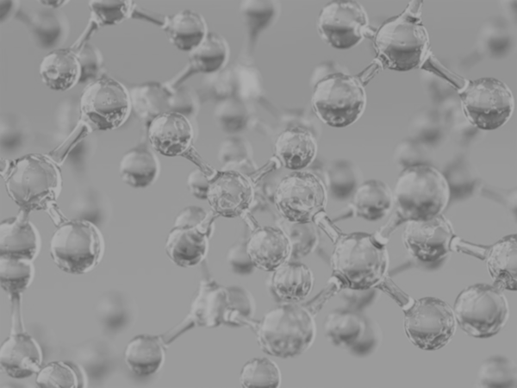


Concrete Strength Prediction
Keng Ming Cheng
University of California, Los Angeles (UCLA)
Contact: kengming_cheng@outlook.com
Physics of AmoRphous and
Inorganic Solids Laboratory

Slide 2
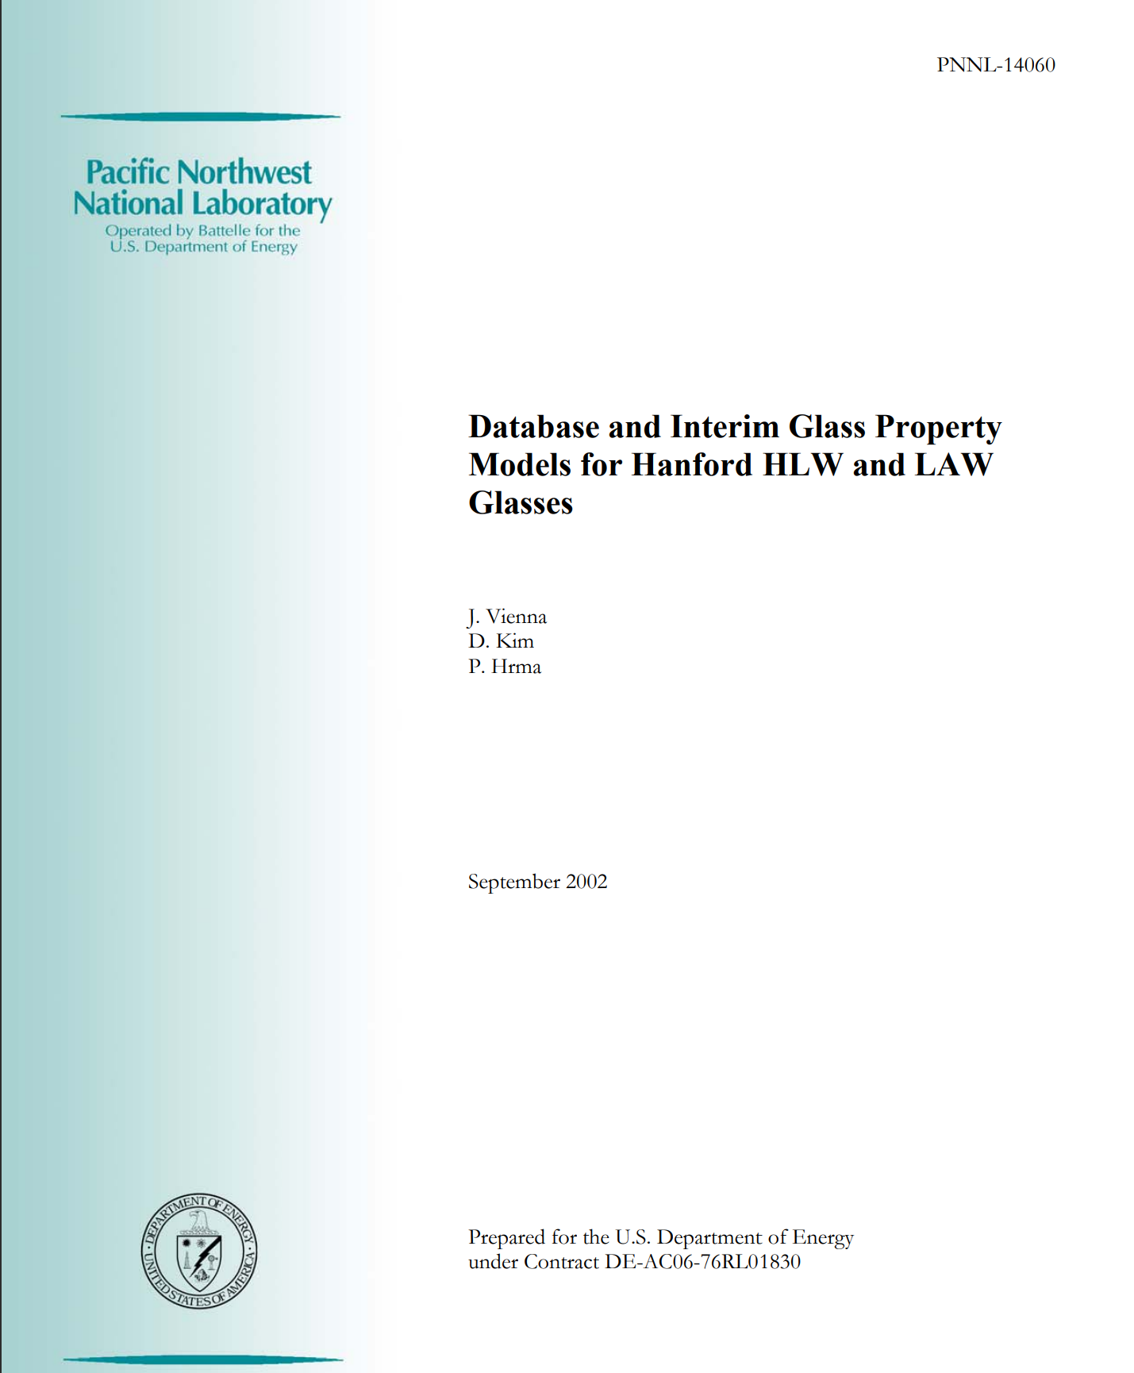
Results
Extract Glass Data

Slide 3
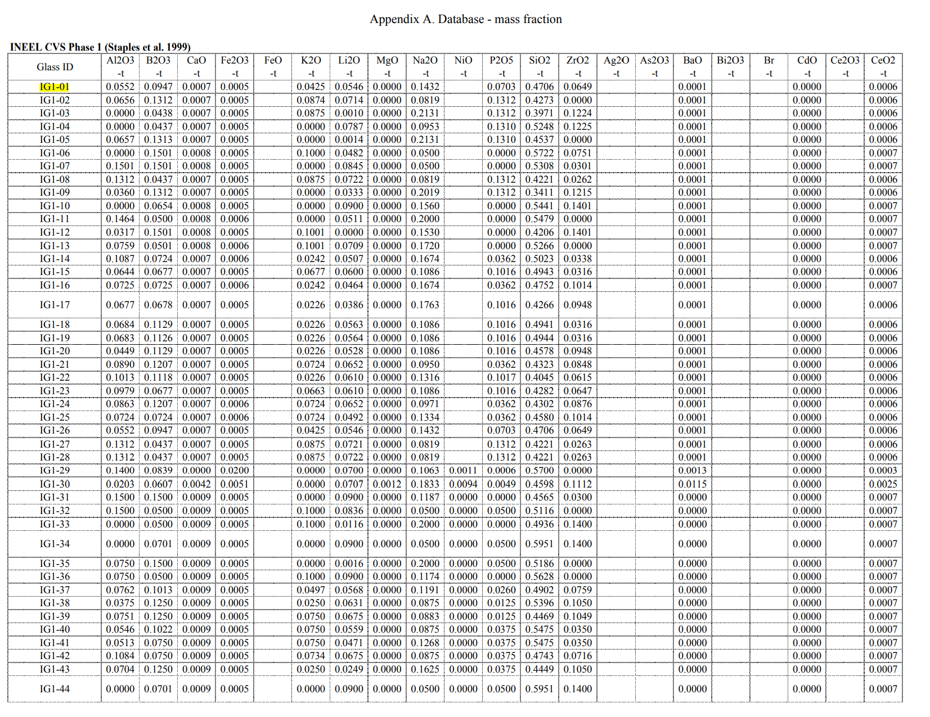

Results
Glass
https://tabula.technology/

Slide 4
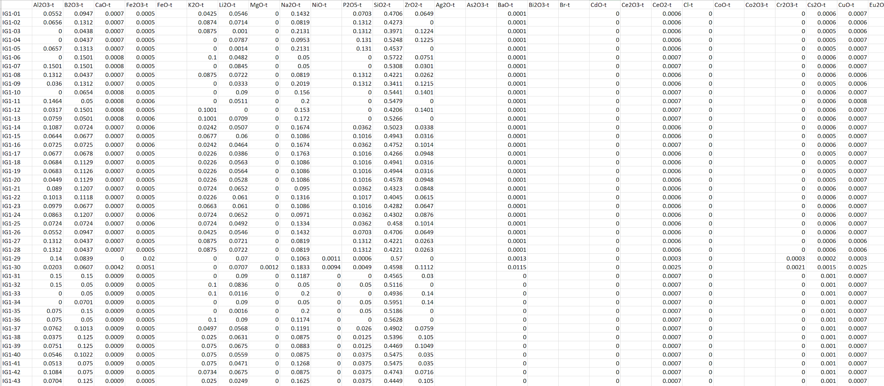
Results
Glass
https://tabula.technology/

Slide 5
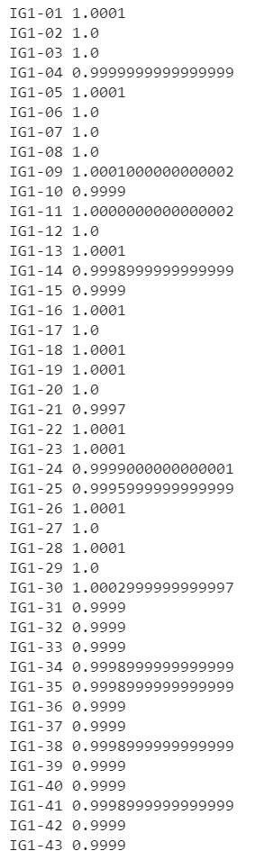
Results
Checking the Accuracy of Extraction
Sum up the fractions of composition for each glass ID
for indx in range(df_data_t.shape[0]):
print(df_data.index[indx], df_data_t.iloc[indx, :end].sum())

Slide 6
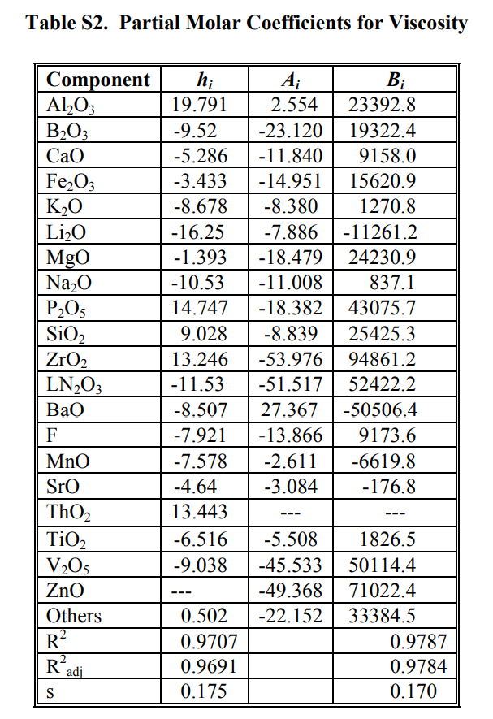
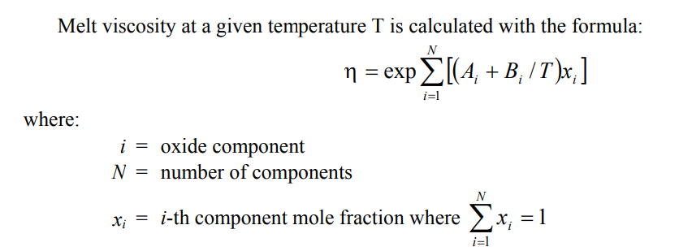
Results
Glass

Slide 7
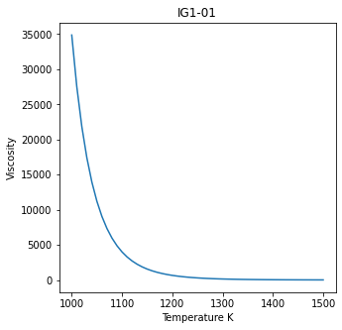

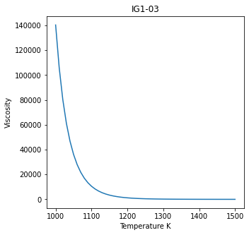
Results
Glass Viscosity vs Temperature

Slide 8
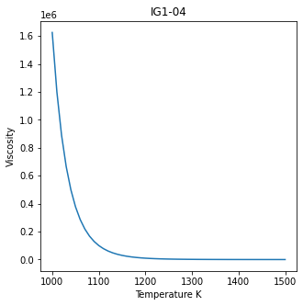
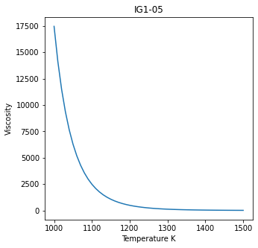
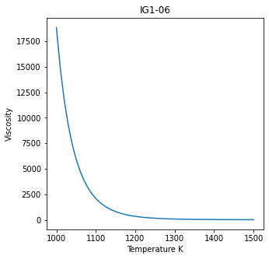
Results
Glass Viscosity vs Temperature

Slide 9
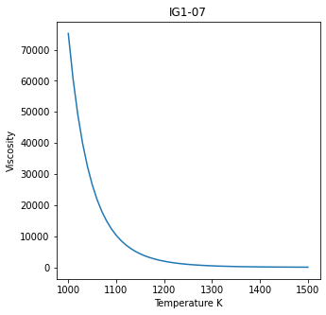
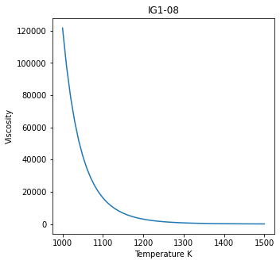
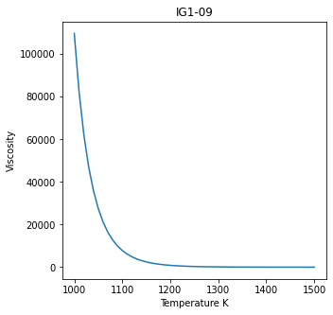
Results
Glass Viscosity vs Temperature

Slide 10
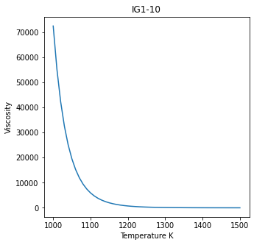
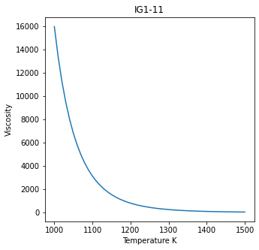

Results
Glass Viscosity vs Temperature

Slide 11
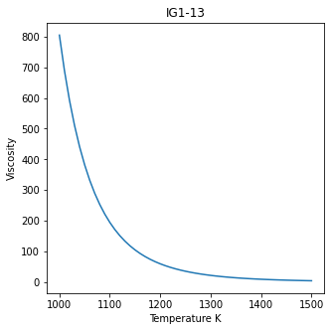
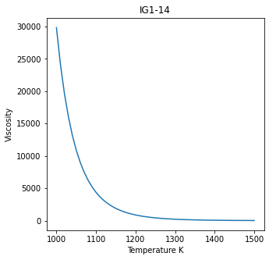

Results
Glass Viscosity vs Temperature

Slide 12
Results
Glass Viscosity vs Temperature

Slide 13
Searching Optimal Value Based on Trained model

Slide 14
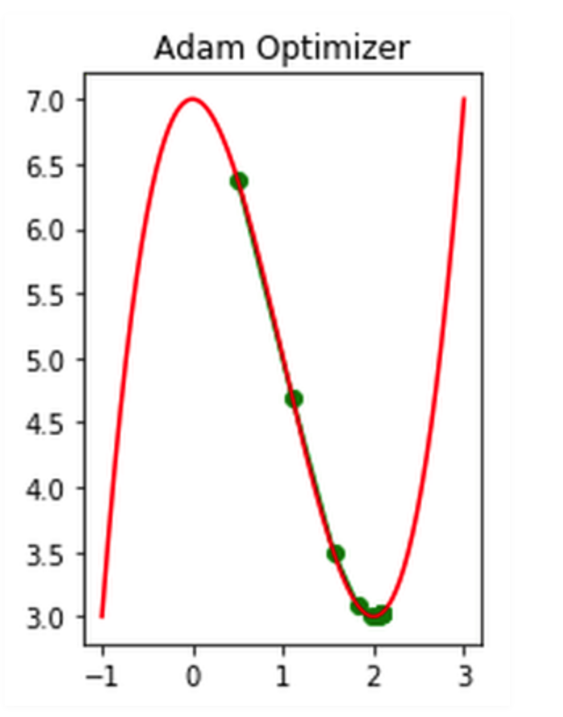
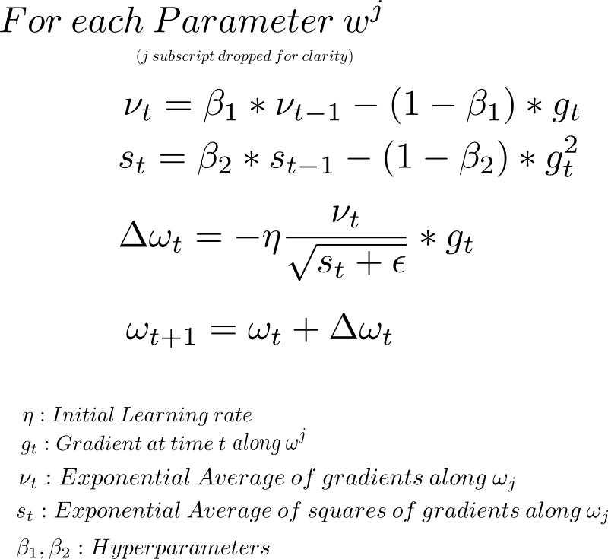
Results
Searching Optimal Value
Using optimizer to approach the global minimum of strength per cost
cost = Sum of input features
Loss = - (Predicted strength) / (Sum of input features)
Use Adam optimizer to get minimum regarding to Loss
opt = tf.keras.optimizers.Adam(learning_rate=0.01)
loss_fn = lambda: tf.constant(-1.0) * (nn_model(var1)*target_scaler.scale_[0]+target_scaler.mean_[0]) * 0.00689476 / tf.reduce_sum(var1*input_scaler.scale_+input_scaler.mean_)
for _ in range(500):
opt.minimize(loss_fn, [var1])

Slide 15
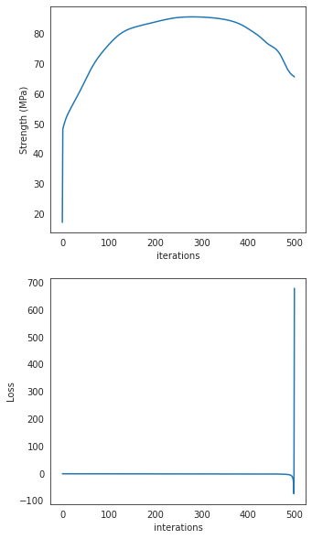
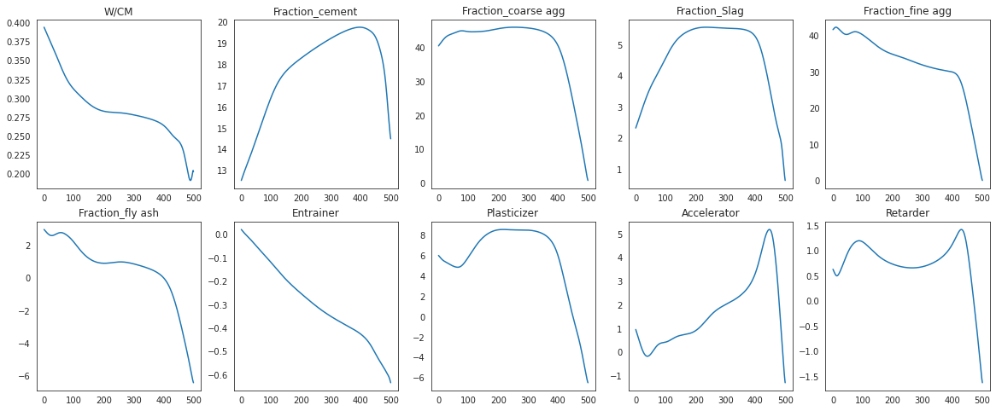
Results
Searching Optimal Value
cost = Sum of input features
Loss = - (Predicted strength) / (Sum of input features)
Use Adam optimizer to get minimum regarding to Loss

Slide 16
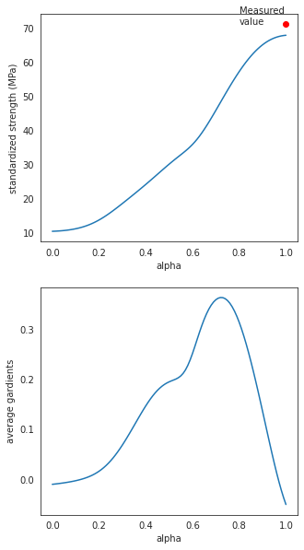
Results
Searching Optimal Value
Integrated Gradients
alpha = 0 represent the values of baseline
alpha = 1 represent the values closed to optimal values
alpha =0 → alpha = 1 searching the path where the optimal values may exist
def compute_gradients(datas,target_class_idx = 0):
with tf.GradientTape() as tape:
tape.watch(datas)
logit = nn_model(datas)
probs = logit
return tape.gradient(probs, datas)
def integral_approximation(gradients):
# riemann_trapezoidal
grads = (gradients[:-1] + gradients[1:]) / tf.constant(2.0)
integrated_gradients = tf.math.reduce_mean(grads, axis=0)
return integrated_gradients
def gradients_for_regression(baseline, data,m_steps=100,batch_size=32,show_measured_data=True):
alphas = tf.linspace(start=0.0, stop=1.0, num=m_steps+1)
interpolated_data = interpolate_datas(baseline, data, alphas)
path_gradients = compute_gradients(datas = interpolated_data)
prediction = nn_model(interpolated_data)

Slide 17
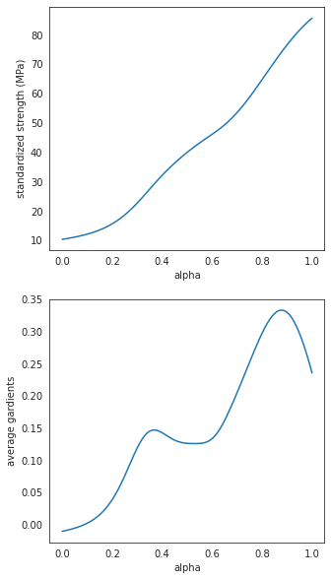
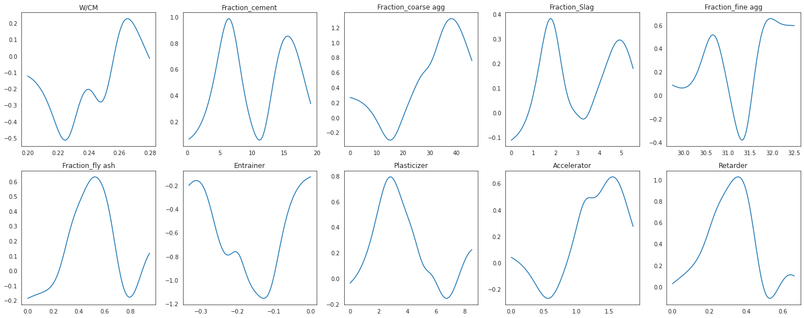
Results
Searching Optimal Value

Slide 18

Notes:
Thank sponsors

Slide 19
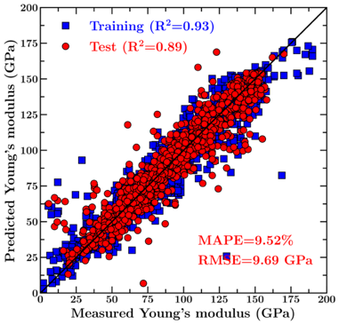
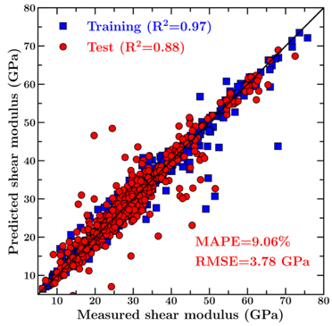
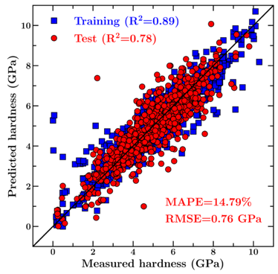
Results
Prediction of Concrete Mechanical Properties
Young’s modulus
Shear modulus
Hardness
> Our model offers a very good prediction of the mechanical properties of test set glasses (which are kept invisible to the model during its training).

